Slide 1
A Scientific Theory is an explanation or model backed by results obtained from many tests or experiments.
Notes:
Instructional Approach(s): Teacher provides definition of a scientific theory and the students record the definition on their notes.

Slide 2
WHY DO THEORIES CHANGE?
Scientific theories change when scientists discover new information
New technology, new tools, and/or new observations can provide new information.
Examples:
Greater telescopes and imaging technology
Notes:
Instructional Approach(s): Teacher asks the students “why do theories change?” and gather a few responses from students. If students cannot come up with responses, let them pair up and possible discuss with another student. However, do not spend more than 2-3 minutes discussing why theories change. After discussions, allow students to answer the question on their notes.

Slide 3
For centuries, there have been a variety of theories to explain the formation and structure of the universe.
We will examine some of these theories and identify the most widely accepted theory today.
Notes:
Instructional Approach(s): Teacher reads the slide as a transition to the theories of the universe.

Slide 4
How and when did the universe begin? No one was around when the universe began, so who can say what really happened?
The best that scientists can do is work out the most foolproof theory, backed up by observations of the universe.
Notes:
Instructional Approach(s): Teacher reads that slide as a transition to the Big Bang Theory.

Slide 5
THE BIG BANG THEORY
The most commonly accepted theory today of the formation of the universe is the Big Bang Theory.
The theory states that the universe originated sometime between 10 billion and 20 billion years ago from an enormous explosion of a small volume of matter at extremely high density and temperature.
Notes:
Instructional Approach(s): The teacher introduces the Big Bang Theory and the students answer a question on their notes about the Big Bang Theory.

Slide 6
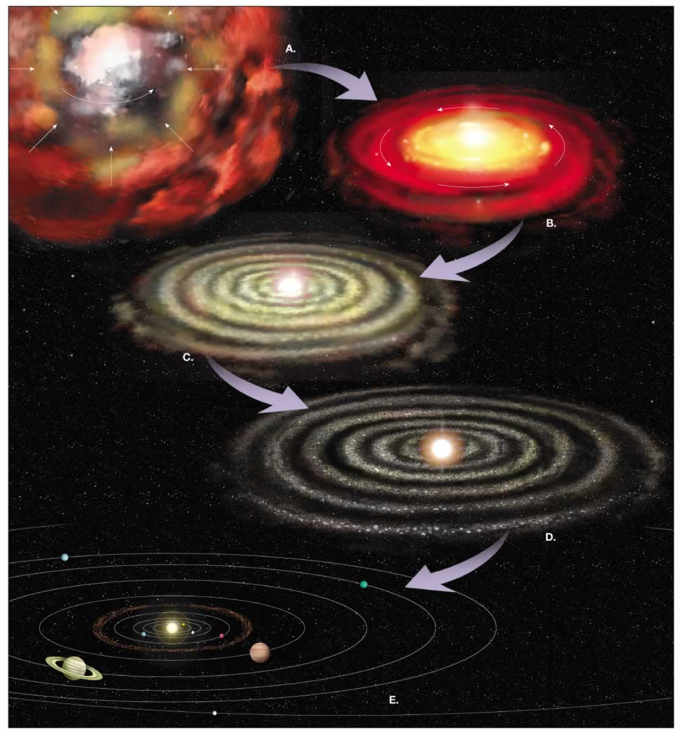
Notes:
Instructional Approach(s): Teacher uses the picture to show how the universe was formed over time in the Big Bang Theory

Slide 7
VISUALIZATIONS OF
THE BIG BANG
http://www.classzone.com/books/earth_science/terc/content/visualizations/es0401/es0401page01.cfm?chapter_no=visualization
video clip of an ice skater spinning http://www.youtube.com/watch?v=AQLtcEAG9v0
Notes:
Instructional Approach(s): Click on the link provided to show a visualization of the Big Bang Theory. o Another analogy that the students might be able to understand is the spinning ice skater. Ask students how many of them have seen an ice skater do a spin. Have students describe it. Show a video clip of an ice skater spinning. You might have noticed that when the twirling ice skater pulls in her arms, she spins faster. The same thing occurs when a cloud of gas, ice, and dust in a nebula contracts. As mass moves toward the center of the cloud, the cloud rotates faster.

Slide 8
DISTRIBUTED SUMMARIZING
Turn to a partner and describe the Big Bang Theory and why it is called
a Theory.
Notes:
Instructional Approach(s): Allow students to turn to a partner (without getting out of their seat), either one they select or if necessary one the teacher assigns, to discuss the Big Bang Theory and why it is a theory. Additionally, have students record on their notes an illustration or example of the formation of the universe by the Big Bang Theory (Balloon Bang, Big Bang Demonstration with the glitter in the water bottle, Ice Skater, or another example).

Slide 9
ANOTHER THEORY ABOUT THE UNIVERSE…
Big Bang theorists claim that all of the galaxies, stars, and planets still hold the explosive motion of the moment of creation and are moving away from each other at great speed.
In 1929, astronomer Edwin Hubble announced that all of the galaxies he had observed were moving back from us, and from each other, at speeds of up to several thousand miles per second.
Since the Big Bang explosion, they reason, the universe has been expanding.
Notes:
Instructional Approach(s): The teacher reads through the information or has students read the information. The third bullet is the “big idea” of the slide. The students should answer the question on their notes about “another theory that is closely associated with the Big Bang Theory”.

Slide 10
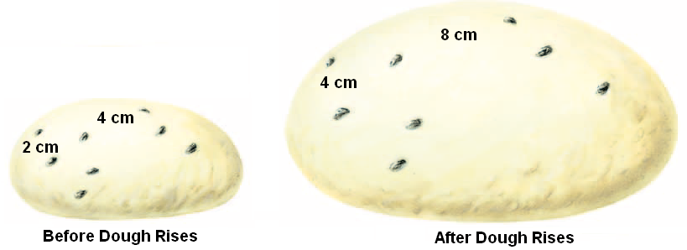
Astronomers use the analogy of cooking raisin bread to demonstrate the expanding universe
Expanding the Universe on a Balloon Demo
Notes:
Instructional Approach(s): The teacher uses the illustration of cooking raisin bread as an example of the expansion of the universe. Students should explain on their notes how cooking raisin bread demonstrates the expansion of the universe. Another approach is to conduct the Expanding the Universe on a Balloon Demonstration. See “Expanding the Universe on a Balloon Demonstration” on the resource page with teacher directions for conducting the demonstration.

Slide 11
THE UNIVERSE AFTER ITS BIG BANG…
The Universe includes living things, planets, stars, galaxies, dust clouds, light, and even time.
The Universe contains billions of galaxies, each containing millions or billions of stars. The space between the stars and galaxies is largely empty.
So, if the universe supposedly was formed by the Big Bang, how did these other objects form?
Notes:
Instructional Approach(s): Teacher reads the slide to transition to the next concept.

Slide 12
THE UNIVERSE AFTER ITS BIG BANG…
As millions of years passed, the dense areas of the universe pulled in material because they had more gravity. Finally, about 100 million years after the Big Bang, the gas became hot and dense enough for the first stars to form. Large clusters of stars soon became the first galaxies.
Notes:
Instructional Approach(s): The teacher should slowly take the students through the animated ppt slide describing what happened after the “big bang”. At the end of the slide, an “in short” box summarizes the events that led to the formation of other objects in our solar system. The students should record how other parts of the universe were formed on their notes.

Slide 13
THE UNIVERSE AFTER ITS BIG BANG…
Scientists believe that Solar Systems formed in similar ways. Giant clouds of dust and gas began to collapse under the weight of its own gravity. As it did so, the matter contained within it began to move in a giant circle, much like the water in a drain moves around the center of the drain in a circle.

Slide 14
THE UNIVERSE AFTER ITS BIG BANG…
At the center of this spinning cloud, a small star began to form. This star grew larger and larger as it collected more and more of the dust and gas that collapsed into it.

Slide 15
THE UNIVERSE AFTER ITS BIG BANG…
Further away from the center of this mass where the star was forming, there were smaller clumps of dust and gas that were also collapsing.
The star in the center eventually ignited forming our Sun, while the smaller clumps became the planets, minor planets, moons, comets, and asteroids.

Slide 16
THE UNIVERSE AFTER ITS BIG BANG…
In short, after the Big Bang, dense clouds of gas and dust from the “bang” either collapsed or stuck together to form the parts of the universe we know today.

