Slide 1

DCSS STEM Fair:
Clarifying the Form process
Pam Walker
STEM Coordinator

Slide 2
Paperwork Deadline
Entry forms due from each school’s science fair coordinator by Jan. 7th at Noon.
6 projects per MS and 8 projects per HS
List alternates in case room permits.
All students that compete in the district fair must have a media release form on file either by the school office or the supervising teacher.
Entry forms on Curriculum and Instruction Site

Slide 3
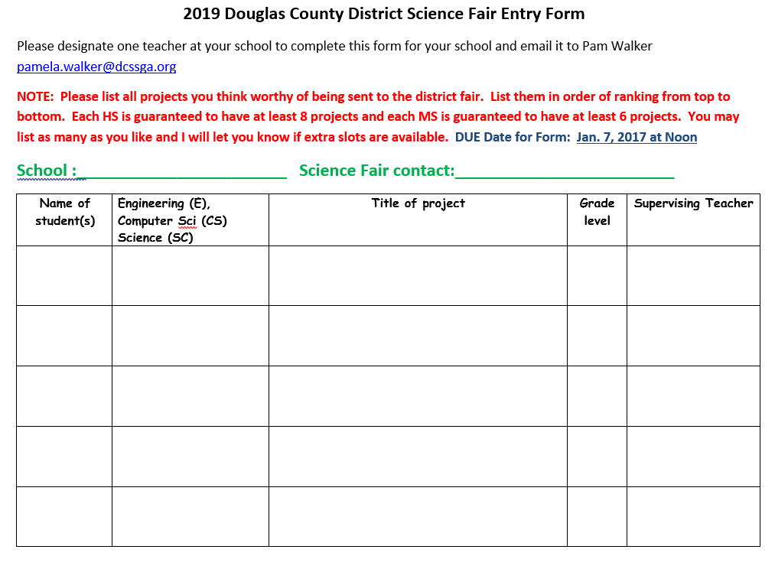

Slide 4
Dates and Details
DCSS events at Murray Education Center
Project Set up times:
Jan. 14th from 3:00-5:30PM or
Jan. 15th from 7:30AM- 10:00AM
Project Judging:
Jan. 15th from 1:00- until finished
Jan. 15th -Student Interviews- 4:00-5:00
Awards Ceremony
Jan. 17th – 6:30PM- 7:30PM
1st and 2nd place winners meet afterwards- Region is at UWGA- Feb. ___
STATE is at UGA- March 28-30

Slide 5
Display and Safety
Nothing that contains chemicals in vials
No syringes, knives, or ammunition
No mechanical devices that have pinch points
No animals, or animal parts
No glass
No plants, dirt or rocks

Slide 6
Please Remember
Students:
must have a logbook and display board
must cite their research references
must bring all required forms completed to display in a notebook in front of project*************
should cite the origin of all graphs and pictures
(note if the student produced all of these, they can put a small card in front of the project that says: All graphs and photos prepared by me)
cannot place QR codes or additional handouts in front of project.
Research notebooks and abstracts in addition to logbooks are highly recommended for projects that have aspirations of making it to State.

Slide 7
First 7 Steps for a successful project
Read your 2018-19 DCSS STEM Fair Handbook/Guidelines and your Time Table for project completion (Found on Curriculum site)
2. Choose a potential project and formulate a scientific or engineering/computer science question/hypothesis.
Fill out and turn in the 1 page Proposed Project form to your teacher. (Found on the Curriculum & Instruction site). She will determine if you project needs approval of the District SRC/IRB committee. DO NOT begin your experimentation until you are give approval from your teacher.

Slide 8
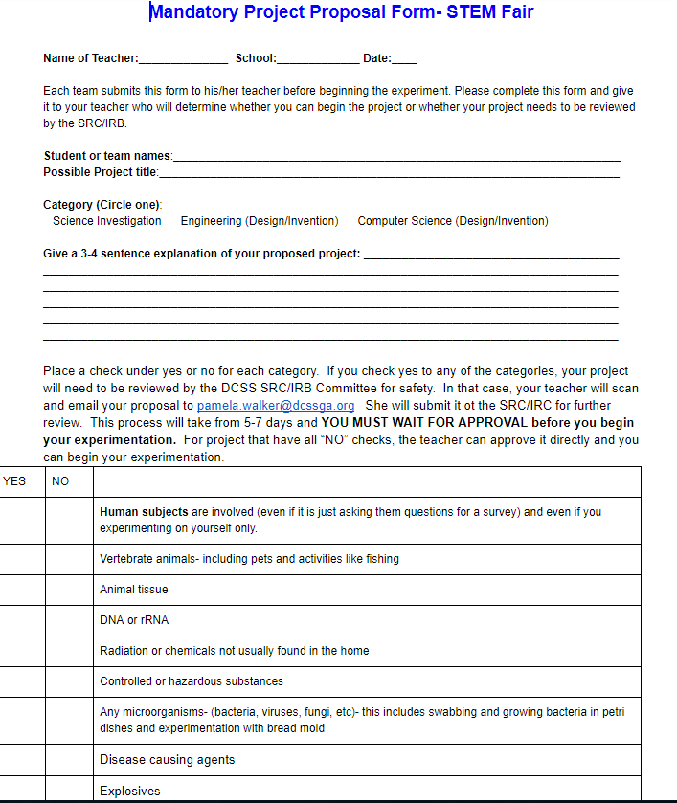
Students complete and give the teacher for approval

Slide 9
Once your project is approved by teacher or the SRC/IRB:
4. One you are granted the go ahead from your teacher to proceed, complete forms 1, 1A, and 1B. Part of 1A is to develop a research plan on how you are going to carry out your experiment (All dates on Form 1 and 1B must be prior to the Start date of experimentation, you enter on Line 7 of form 1A). The next slide give you the location of the forms.

Slide 10
First 7 Steps for a successful project
NOTE: All projects MUST complete Form 1, 1A (including the research plan), and 1B.
5. Download the required form document. Direct access through live links are found here to all possible forms. You may type directly on the forms and print: https://www.georgiacenter.uga.edu/sites/default/files/gsef-2019-required-forms-approvals.pdf
6. It is possible your project will require additional forms. To find out what other forms you may need, you should use the 60 second Form wizard to give you that information: https://apps2.societyforscience.org/wizard/index.asp
7. There is an official rulebook that you will want to access to help answer questions as they relate to your project, i.e. if you are using human participants, pay special attention to the Human Consent form. https://student.societyforscience.org/international-rules-pre-college-science-research

Slide 11
A very easy way to access individual forms is through the link below. It also gives you hints on how forms should be dated, etc.
https://www.georgiacenter.uga.edu/sites/default/files/gsef-2019-required-forms-approvals.pdf

Slide 12
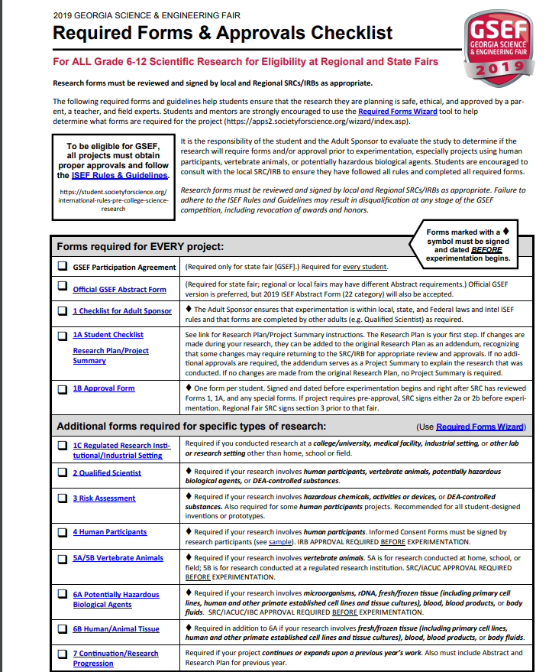
Required Forms Access
Rule Book Access
Direct access to form wizard
Active links to all possible forms
All projects marked with a diamond symbol must be dated and signed before experimentation begins

Slide 13
Details on form completion
FORM 1A/Checklist
Students – Complete Form 1A/Student Checklist to the best of your knowledge. (Only 1 per project required) .
a. Pay special attention to question #5. You may need to come back to this question after filling out Form 1.
b. Prior approval by our SRC/IRB is required if humans, vertebrate animals, microorganisms, body fluids, tissue cultures, controlled substances or potentially hazardous biological agents are used in your project. (You learned this when you submitted your project proposal document)
c. Question #7 – make sure your experimentation start date occurs after the SRC/IRB approval date if required for your project.
d. Question #9 – Use complete addresses
e. Question #10- Complete a research plan
f. Question #11- Complete an abstract.

Slide 14
More About form 1A- The Research Plan
Some students forget to do the research plan that goes with Form 1A. Specific directions are on page 2 of the document. Once your proposal is approved, you should go ahead and do your research plan.
Details are given of what should be in the research plan at the end of Form 1A. It should be written prior to experimentation as to what you will be doing.
See the next 2 slides for some examples.

Slide 15
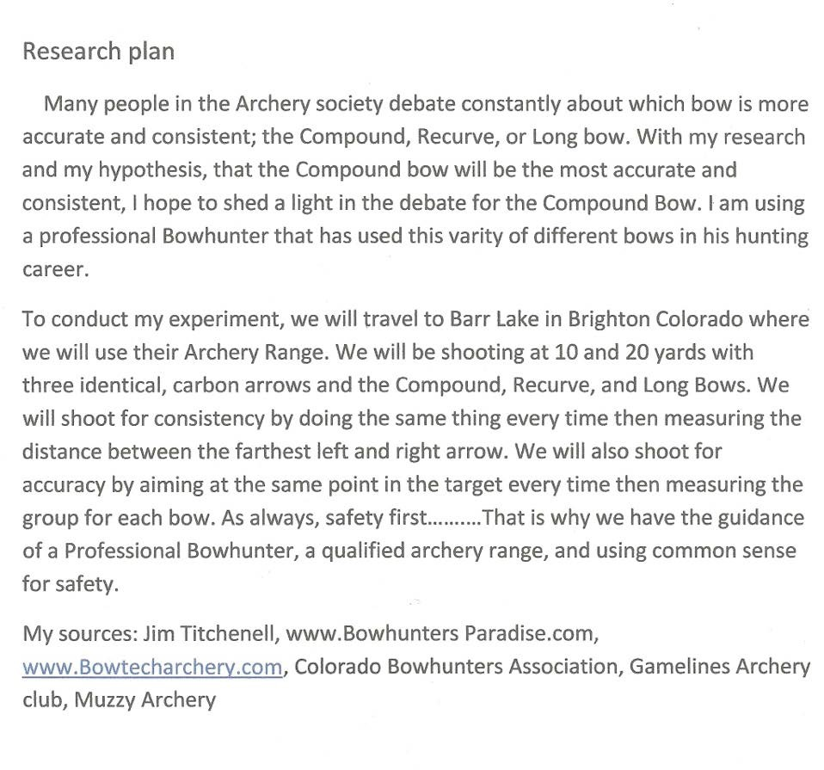
SRC/IRB
Pre-Approval needed
Human participation- Form 4

Slide 16





Question: If we use the solvent extraction method with Decanoic acid in different ratios of water to simulated saltwater, will we able to desalinate water at an effective rate?
Ratios (Acid to water): 25:1 20:1 15:1 10: 5:1 1:1
Hypothesis: If we use the solvent extraction method with Decanoic Acid to remove salt from water, then we will find that the Decanoic acid at the 20:l and 15:1 ratios will work because those ratios are the closest to the original test.
Materials:
1 litre >98% Decanoic Acid
1 litre of distilled water
35g of table salt
Hot plate with magnetic stirring capabilities
100mL Beaker
100mL Separation Funnel
Electric Meter
Procedures
Mix 1L of water with 35g of salt. Stir until fully dissolved.
Take 2mL of the solution and mix with 50 mL of Decanoic acid in the 100 mL beaker. Put onto a hot plate and heat to 70°C with continual stirring for 1 hour.
After stirring is finished, turn the heat off and remove from hot plate. Let it cool and gravitationally separate. Using the glass pipet, carefully
remove the transparent liquid from the solution.
Add the liquid into a small graduated cylinder. Use the electric meter to record the electrical resistance of the liquid. Record Data.
Repeat step 3-5 9 more times, then another 10 for each of the given ratios until the test stops to work. From that point, test each ratio 1 part of acid up until the ratio with the highest efficiency is found.
Observe and record data.
Make a conclusion based on data and observations.
Safety Precautions
Take great care with the Decanoic acid solutions because they are corrosive and hazardous. The Decanoic acid is flammable. Nitrile gloves will be worn and an experienced chemist will be over watching.
Hot plates provide a hazard because of their hot temperatures in this experiment for an extended period of time. Great care will be taken to avoid making direct contact with a hot plate and there will be an experienced supervisor over watching.
Bibliography
“Solvent Extraction” Britannica School. N.p., n.d., Web., 08 Oct 2014
Bajpayee Anurag, Tengei Luo, Andrew J. Muto, and Gang Chen. “Very Low Temperature Membrane Free Desalination by Directional Solvent Extraction.” Supplementary Material (ESI) for Energy & Environmental Science (2011): n. pag Printhttp://www.rsc.org/suppdata/ee/c1/c1ee01027a/c1ee01027a.pdf
“Capric Acid.” Wikipedia. Wikimedia Foundation, 10 July 2014. Web. 08 Oct. 2014.
“Seawater.” Britannica School. N.p., n.d. Web. 08 Oct. 2014.
“Taking the Salt out of Water with Oil.” Taking the Salt out of Water with Oil. N.p., n.d, Web. 08 Oct. 2014 http://mpc- www.mit.edu/agenda/item/140-taking-the-salt-out-of-water-with-oil
Gregory, Michael J. “Organic Chemistry, Biochemistry” Organic Chemistry. Clinton Community College, Web. 08 Dec. 2014http://faculty.clintoncc.suny.edu/faculty/michael.gregory/files/bio%20101/bio%20101%20lectures/biochemistry/biochemi.htm
No SRC/IRB
Approval needed but would need a qualified scientist form

Slide 17
Form Completion
APPROVAL FORM 1B
Students with their parents, will fill out Approval Form 1B, making sure to include all signatures that the project requires.
a. Please note: Question #1 – Student & Parent signatures must be prior to the start of experimentation.
b. Question 2 – If you have determined you need SRC/IRB approval, the signatures also need to be prior to experimentation.
c. Question 3 –Please leave blank.
Checklist for Adult Sponsor- Form 1
Your Adult Sponsor needs to complete the Checklist for Adult Sponsor Form 1 and it must be signed prior to the start of experimentation. They will do this using the answers from Form 1A and the student Research Plan.
Risk Assessment Form 3
All students in DCSS should complete the Risk Assessment Form 3. This is done by the student in collaboration with the person that will supervise the project. Form must be signed prior to the start of the Experiment.

Slide 18
Required Paperwork

Slide 19
SRC/IRB prior Approval
Once you submit your project proposal to your teacher, she/he will either approve it or will determine it requires SRC/IRB pre-approval BEFORE you begin your experimentation. The Rule Wizard, Project Proposal and the Flow Chart will indicate this.
If that is the case, DO NOT BEGIN YOUR EXPERIMENT YET!!!! Your teacher will scan your proposal and email pamela.walker@dcssga.org She will send the proposal to committee members and respond to you within 5-7 days if your project is acceptable or what adjustments need to be made to it. The committee members will provide the needed signatures where required.
(See the flow chart that follows to double check if your project needs SRC approval. It never hurts to double check)

Slide 20
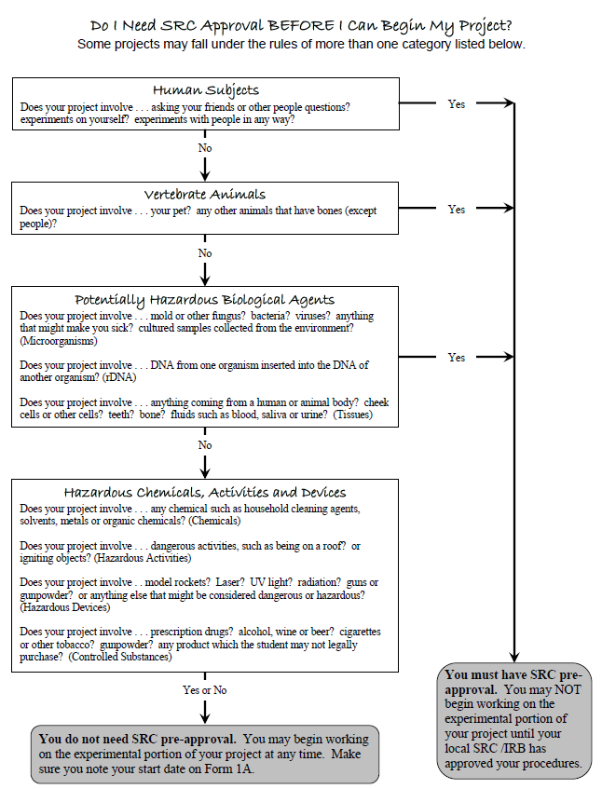

Slide 21
Forms that apply to all projects advancing past District
Official Abstract Form (complete after experimentation is complete)
http://www.georgiacenter.uga.edu/sites/default/files/gsef-2018-abstract.pdf
Checklist for Adult Sponsor (Form 1) – 1 per project -Must be signed BEFORE experimentation begins (check dates/signatures)
http://www.georgiacenter.uga.edu/sites/default/files/gsef-2018-abstract.pdf
Student Checklist (Form 1 A). Step 10 requires that you complete a Research Plan/Project Summary and attach it to this form -page 2 of the document gives directions on how to write the research plan
https://sspcdn.blob.core.windows.net/files/Documents/SEP/ISEF/2019/Forms/1A-Student-Checklist-Research-Plan-Instructions.pdf
Approval (Form 1B) completed by each student if a team - Must be signed BEFORE experimentation begins – also SRC/IRB approval (if required) BEFORE experimentation
https://sspcdn.blob.core.windows.net/files/Documents/SEP/ISEF/2019/Forms/1B-Approval-Form.pdf
Risk Assessment (Form 3)- all DCSS projects must fill out one of these and it must be signed PRIOR to experimentation begins.
https://sspcdn.blob.core.windows.net/files/Documents/SEP/ISEF/2019/Forms/3-Risk-Assessment.pdf

Slide 22
Form 3- Risk Assessment
This form is Required for all projects in Douglas County
Some Examples of hazards include:
  Prescription Drugs
  Alcohol and Tobacco
  Hazardous Chemicals (e.g., bleach, fertilizer, etc.)
  Hazardous Devices
(e.g., power tools, knives, guns, arrows, etc.)
  Hazardous Activities
(e.g., cutting, sawing, cooking, ladders, etc.)
  Radiation

Slide 23
Some projects may need these
Additional Forms

Slide 24
Form 2- Qualified Scientist
Should have a professional degree related to student research Or Have applicable experience and expertise with review and approval by the SRC
May be required if your research involves human participants, vertebrate animals, potentially hazardous biological agents, or DEA-controlled substances.
Must be completed and signed before the start of the experiment.
A designated supervisor can provide direct supervision in some cases.
Form access:
https://sspcdn.blob.core.windows.net/files/Documents/SEP/ISEF/2019/Forms/2-Qualified-Scientist.pdf

Slide 25
Human Participants Research
The district IRB must review and approve the research plan before experimentation begins
Research participants 18 years of age or older must give informed consent
Research participants under 18 must give assent and their parents may be required to give written permission
Form 4 required even if the student is the only subject of the research as well as if the participants are only giving feedback on a prototype.
https://sspcdn.blob.core.windows.net/files/Documents/SEP/ISEF/2019/Forms/4-Human-Participants.pdf
The IRB decisions are documented and signed on Form 4: Human Participants and Informed Consent Form.

Slide 26
If IRB determines that written informed consent/assent or parental permission is required, documentation is obtained on an “informed consent” document-
see the sample one given

Slide 27
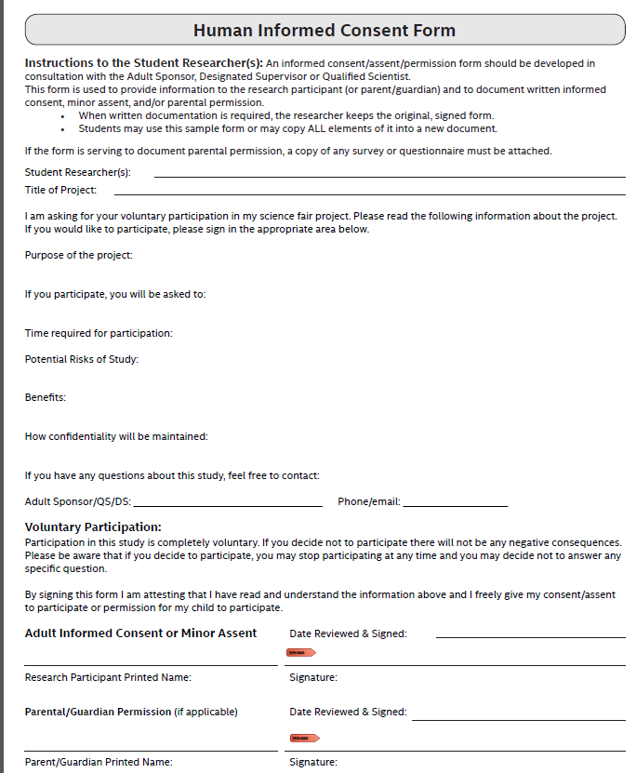
https://sspcdn.blob.core.windows.net/files/Documents/SEP/ISEF/2019/Forms/4-Sample-Informed-Consent.pdf

Slide 28

Vertebrate Animals

Slide 29
Vertebrate Animal Forms
Required if your research involves vertebrate animals.
5A is for research conducted at home, school, or field. This requires SRC approval before the EXPERIMENTATION!
5B is for research conducted at a regulated research institution. (must have the Institutions’ IACUC/SRC approval BEFORE EXPERIMENTATION! )
https://sspcdn.blob.core.windows.net/files/Documents/SEP/ISEF/2019/Forms/5AB-Vertebrate-Animal.pdf

Slide 30
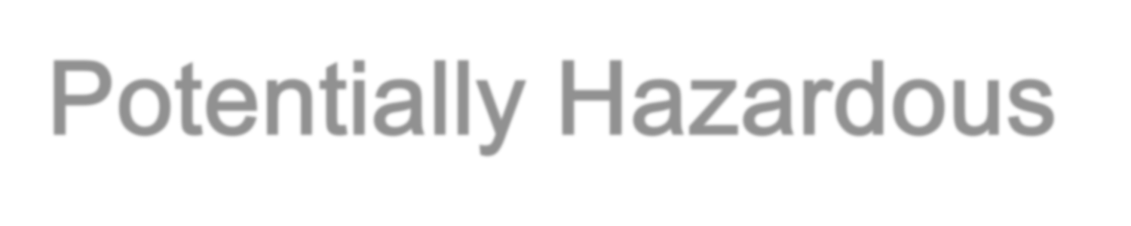
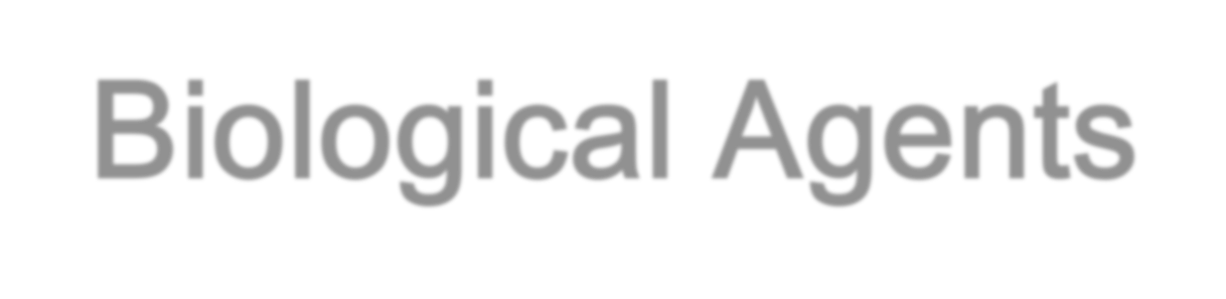
Potentially Hazardous Biological Agents

Slide 31
6A: Potentially Hazardous Biological Agents
Required if your research involves:
microorganisms,
rDNA,
fresh/frozen tissue (including primary cell lines,
human and other primate established cell lines and tissue cultures),
blood,
blood products, or
body fluids.
SRC/IACUC/IBC APPROVAL REQUIRED BEFORE EXPERIMENTATION!
Must be signed and dated before the experiment begins!
https://sspcdn.blob.core.windows.net/files/Documents/SEP/ISEF/2019/Forms/6A-Potentially-Hazardous-Biological-Agents.pdf

Slide 32
6B: Human/Animal Tissue
Required in addition to 6A if your research involves:
fresh/frozen tissue (including primary cell lines, human and other primate established cell lines and tissue cultures),
blood,
blood products, or
body fluids.
https://sspcdn.blob.core.windows.net/files/Documents/SEP/ISEF/2019/Forms/6B-Human-Vertebrate-Animal-Tissue.pdf
Must be signed and dated before the experiment begins!

Slide 33
Form 1C Regulated Research Setting
Required if you conducted research at a:
college/university,
medical facility,
industrial setting,
other lab or research setting other than home, school or field.
This form is completed AFTER experimentation by the adult supervising the student.
https://sspcdn.blob.core.windows.net/files/Documents/SEP/ISEF/2019/Forms/1C-Regulated-Research-Institution.pdf

Slide 34
Forms done- now what?
All students that have projects that advance to the Douglas County District science and engineering fair must bring all completed (signed and properly dated) forms with them when projects are checked in. Failure to do this can hurt your chances of advancing to region or state competition)
Students should place the forms in a notebook that will be placed in front of the project.
It is also a good idea to include an abstract and put it in a clear plastic stand in front of the project.

Slide 35
Questions??

